Slide 1
Tasks for the day
CGI preview: AnalyticalStot and EntropyOfMixing CGIs
Blackboard work: Deriving the “Fundamental Equations” of Thermodynamics

Slide 2
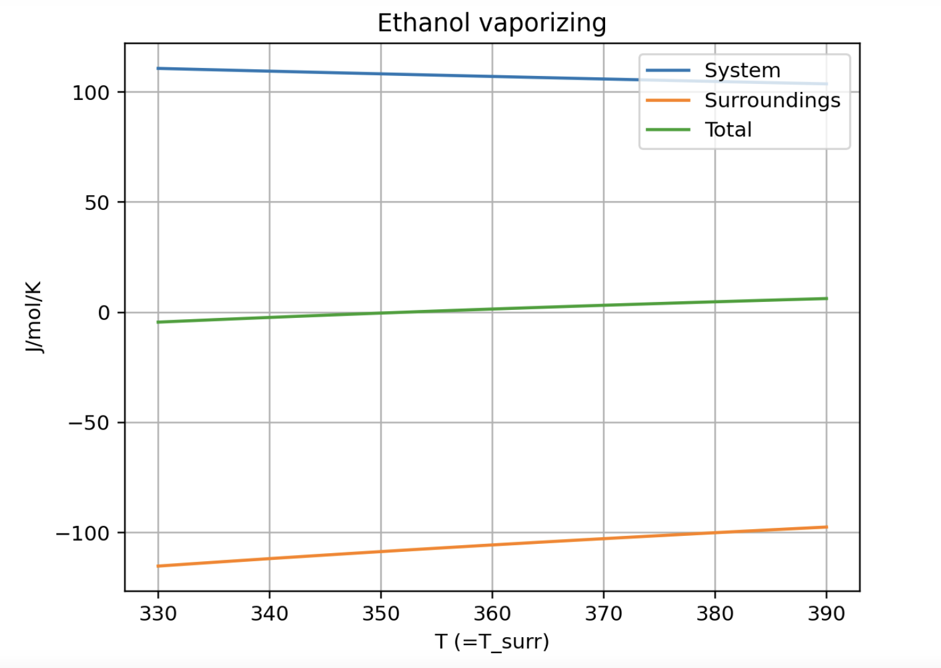
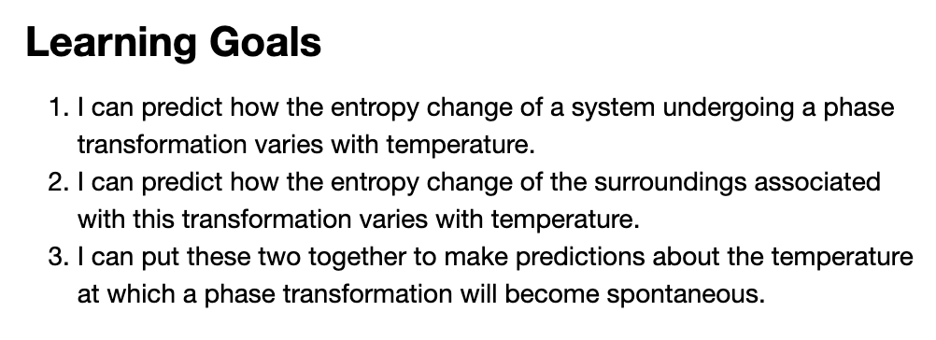
CGI: Week_11a.AnalyticalStot

Slide 3
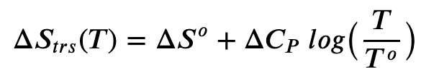

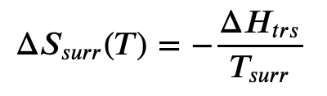
CGI: Week_11a.AnalyticalStot

Slide 4
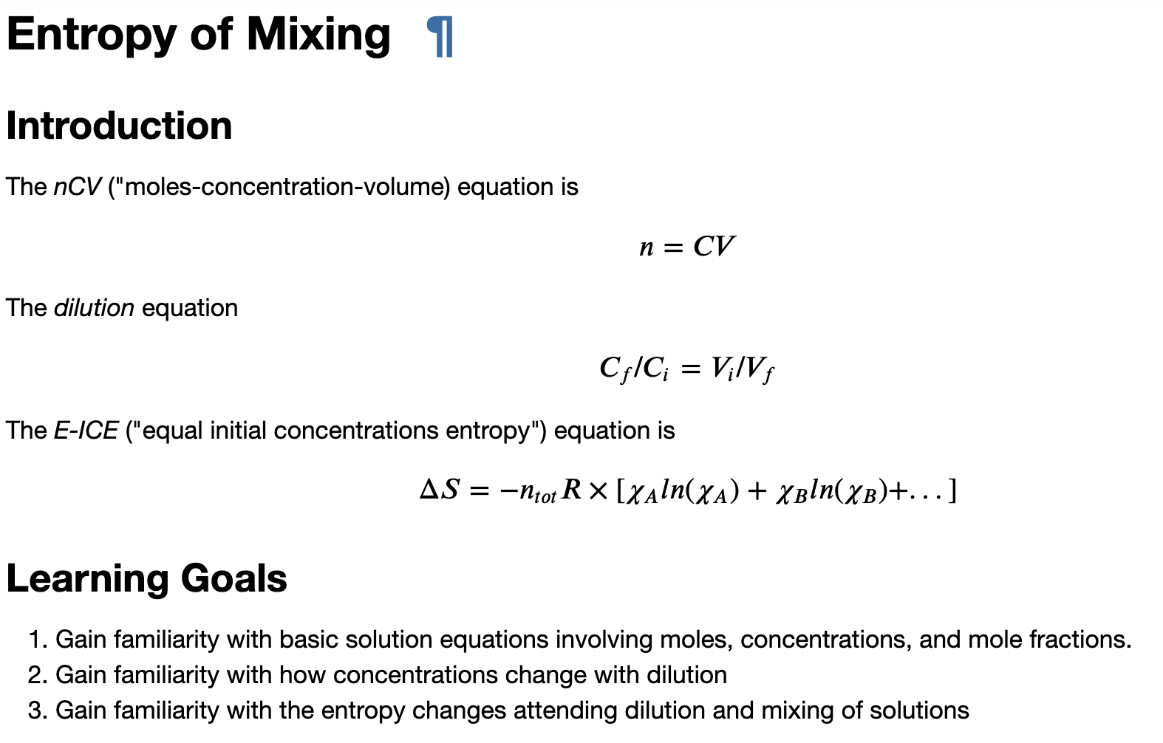
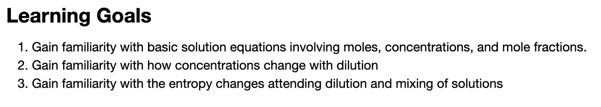
CGI: Week_11b.EntropyOfMixing
A
B
A
B
A
B

Slide 5




CGI: Week_11b.EntropyOfMixing
A
B
A
B
A
B
$${∆S}_{mix}$$
$$0$$
$$χ_{A}$$
$$1$$

Slide 6

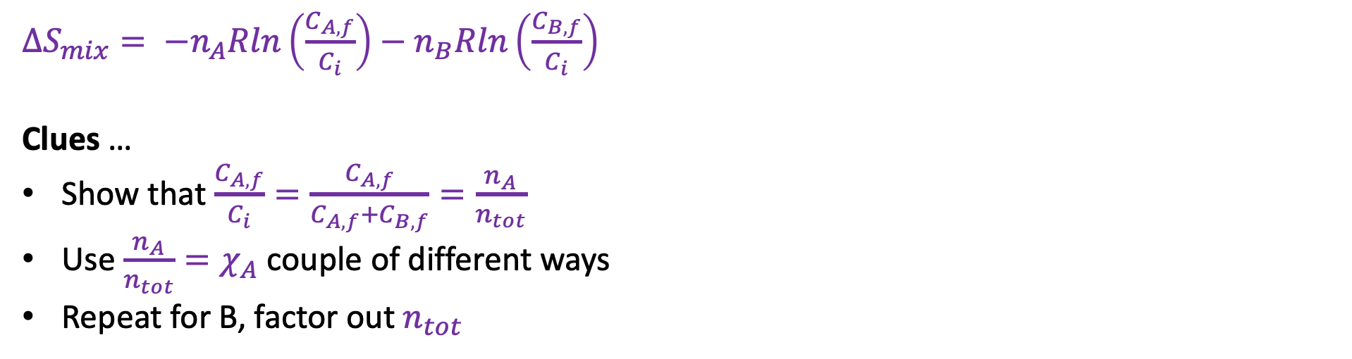




Blackboard: A derivation of the E-ICE equation for entropy of mixing
$$n_{A}$$
$$c_{B,f}$$
$$n_{B}$$
$$c_{A,f}$$
Same initial concentration “$c_{i}$”
$∆S_{mix}= −n_{A}Rln\left(\frac{C_{A,f}}{C_{i}}\right)−n_{B}Rln\left(\frac{C_{B,f}}{C_{i}}\right)$
Clues …
Show that $\frac{C_{A,f}}{C_{i}}=\frac{C_{A,f}}{C_{A,f}+C_{B,f}}=\frac{n_{A}}{n_{tot}}$
Use ${\frac{n_{A}}{n_{tot}}=χ}_{A}$ couple of different ways
Repeat for B, factor out $n_{tot}$
$∆S_{mix}=−n_{tot}R\left[χ_{A}ln\left(χ_{A}\right)+χ_{B}ln\left(χ_{B}\right)\right]$

Slide 7
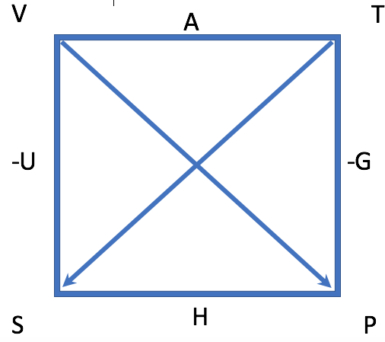
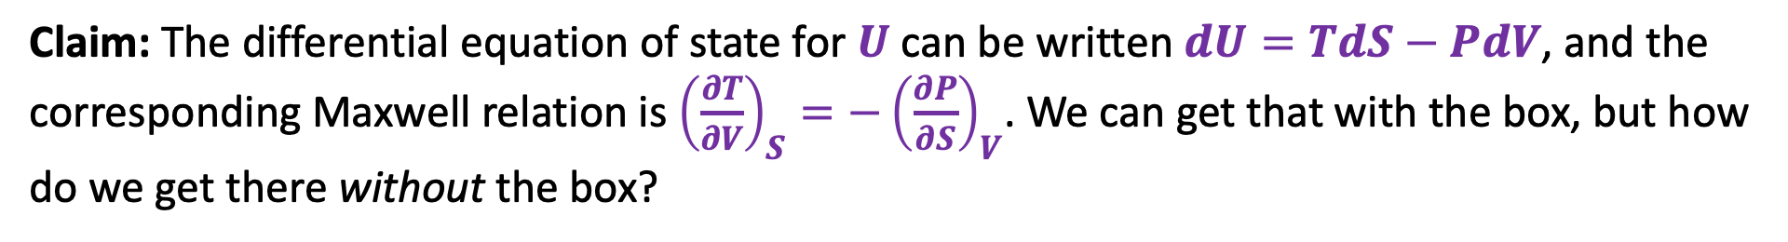
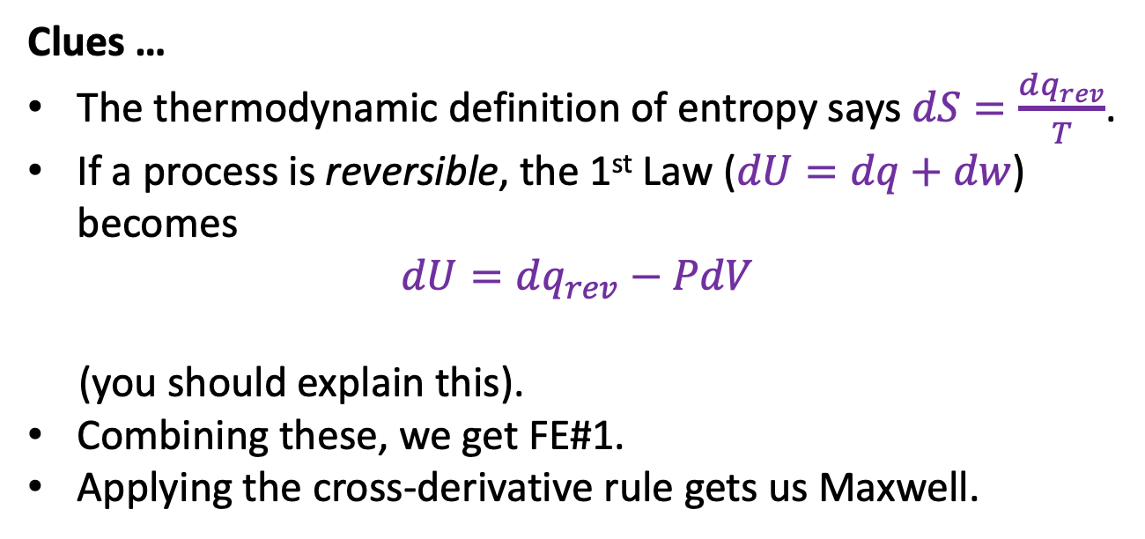
Blackboard: Deriving FE#1
Claim: The differential equation of state for $U$ can be written $dU=TdS−PdV$, and the corresponding Maxwell relation is ${\left(\frac{∂T}{∂V}\right)}_{S}=−{\left(\frac{∂P}{∂S}\right)}_{V}$. We can get that with the box, but how do we get there without the box?
Clues …
The thermodynamic definition of entropy says $dS=\frac{dq_{rev}}{T}$.
If a process is reversible, the 1st Law ($dU=dq+dw$) becomes
$$dU=dq_{rev}−PdV$$
(you should explain this).
Combining these, we get FE#1.
Applying the cross-derivative rule gets us Maxwell.
By the way: There are actually three other Fundamental Equations; but these others are basically restatements of the same idea.

Slide 8
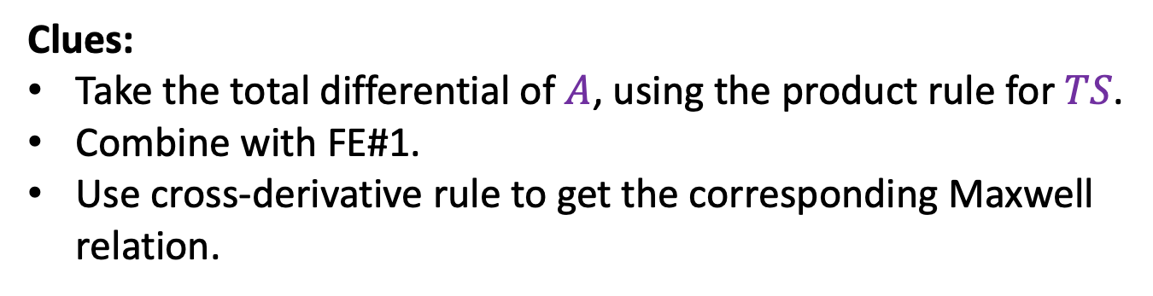
Blackboard: Deriving FE#2
The Helmholtz energy is defined by $A≡U−TS$. What’s the differential equation of state for $A$? What’s the corresponding Maxwell relation?
Clues:
Take the total differential of $A$, using the product rule for $TS$.
Combine with FE#1.
Use cross-derivative rule to get the corresponding Maxwell relation.

Slide 9
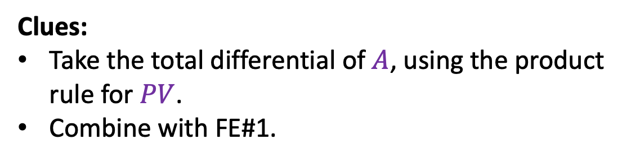
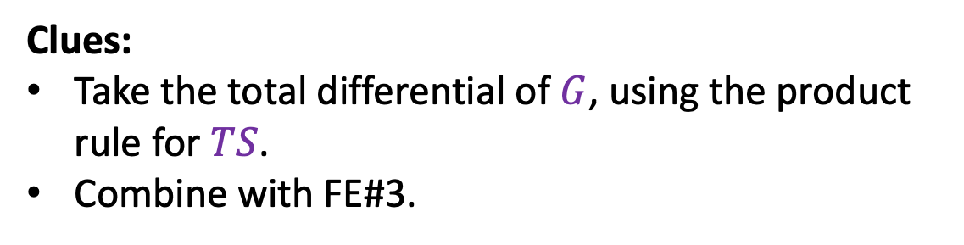

Blackboard: Deriving FE#3 & 4
The Enthalpy is defined by $H≡U+PV$. What’s the differential equation or state for $H$? What’s the corresponding Maxwell relation?
Clues:
Take the total differential of $A$, using the product rule for $PV$.
Combine with FE#1.
The Gibbs Energy is defined by $G≡H−TS$. What’s the differential equation or state for $G$? What’s the corresponding Maxwell relation?
Clues:
Take the total differential of $G$, using the product rule for $TS$.
Combine with FE#3.

Slide 10
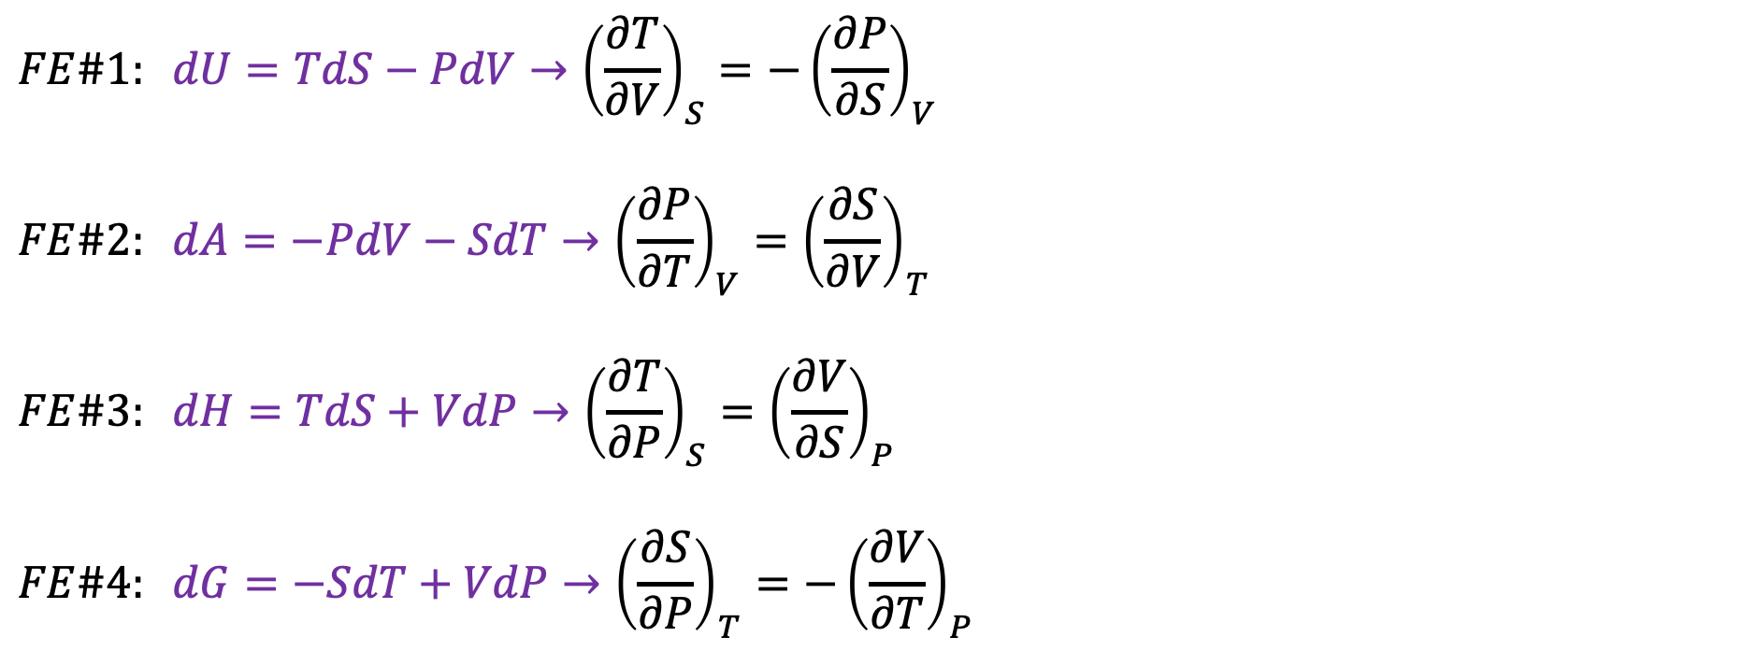
Fundamental equations, Maxwell Relations, and the Box
$$FE\#1: dU=TdS−PdV→{\left(\frac{∂T}{∂V}\right)}_{S}=−{\left(\frac{∂P}{∂S}\right)}_{V}$$
$$FE\#2: dA=−PdV−SdT→{\left(\frac{∂P}{∂T}\right)}_{V}={\left(\frac{∂S}{∂V}\right)}_{T}$$
$$FE\#3: dH=TdS+VdP→{\left(\frac{∂T}{∂P}\right)}_{S}={\left(\frac{∂V}{∂S}\right)}_{P}$$
$$FE\#4: dG=−SdT+VdP→{\left(\frac{∂S}{∂P}\right)}_{T}=−{\left(\frac{∂V}{∂T}\right)}_{P}$$

